Slide 1
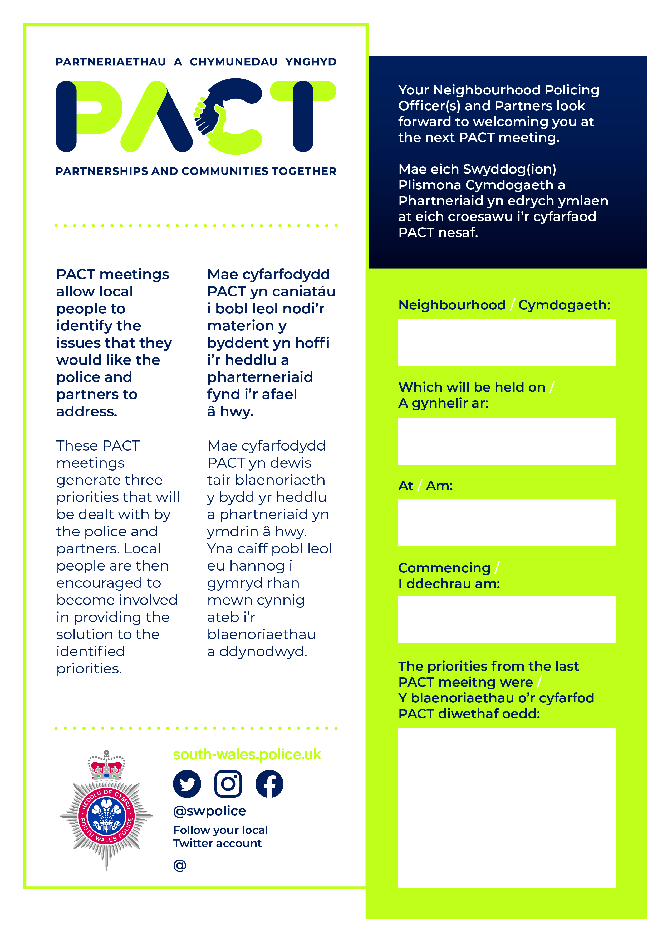
TROWBRIDGE
03/09/2026
CCHA TROWBRIDGE COMMUNITY CENTRE,
CF31RU
18:00
E-bikes
Insert Twitter handle

